Slide 1
Detection of Phishing Website using Machine Learning Model based URL Analysis
Week- 4 & 5 : Data Visualization and Initial Feature Extraction
Priyanka Patil

Slide 2

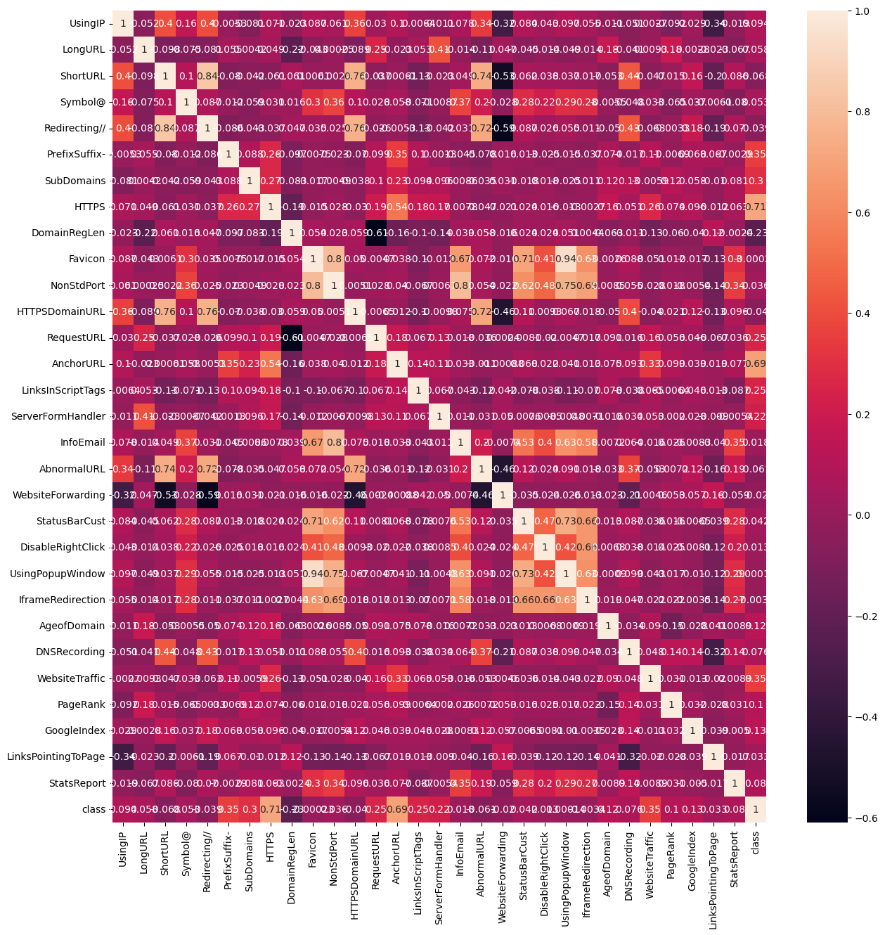



Data Visualization: Few Graphs have been plotted to show the relation between the features in the data set.
Correlation Heatmap

Slide 3
A correlation heatmap is a graphical representation of a correlation matrix, which in turn is a table showing correlation coefficients between variables. Each cell in the table shows the correlation between two variables. The heatmap encodes the values of these coefficients with color, providing an easy-to-read visual summary of how each variable is related to the others.
Purpose - The primary purpose of a correlation heatmap is to show pairwise correlations between variables. It's particularly useful when we have several variables and need to understand the inter-relationships among them at a glance.
Representation - Each cell in the heatmap shows the correlation coefficient between two variables, represented by the intersecting row and column. The color and the number within each cell represent the strength and direction of the correlation:
Positive Correlation: If the coefficient is close to 1, it is shaded with a stronger intensity of one color (pink /red), indicating a strong positive correlation.
Negative Correlation: If the coefficient is close to -1, it is shaded differently (blue/black), showing a strong negative correlation.
No Correlation: A coefficient close to 0 indicates no linear relationship, and these cells are usually shaded neutrally.
Diagonal: Coefficients of 1 down the diagonal where each feature correlates perfectly with itself.

Slide 4
INTERPRETATION OF THE GRAPH COLORS:
High Positive Correlation (Dark Reds): If two features like LongURL and UsingIP have a dark red square between them, this may suggest that phishing URLs tend to both be longer and use IP addresses rather than domain names. A high positive correlation between these features means that when one feature is present (e.g., a URL is long), the other is also likely to be present (e.g., the URL uses an IP address).
Low or No Correlation (Whites): If there’s a feature like HTTPS that has a white square in relation to Favicon, this means there’s little to no linear relationship between them. In practice, whether a URL uses HTTPS or not is independent of the favicon's properties.
High Negative Correlation (Dark Blues): If a feature such as AgeofDomain has a dark blue square with the class label, it could imply that newer domains (lower AgeofDomain) are more commonly associated with phishing (class label indicating phishing), while older domains are less likely to be phishing sites.

Slide 5
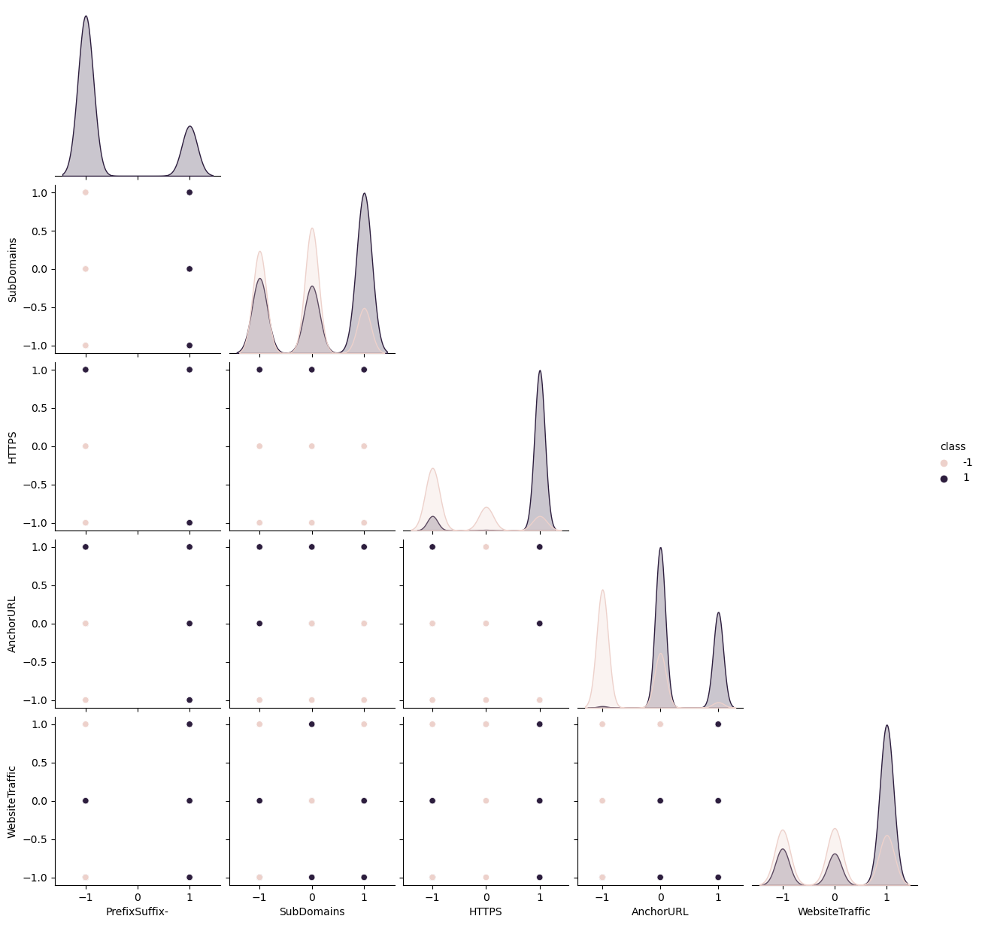
PAIRPLOT FOR PARTICULAR FEATURES

Slide 6
A pair plot is a matrix of scatterplots that allows you to see both the distribution of single variables and relationships between two variables
What is a Pair Plot?
Diagonal: The diagonal of a pair plot typically shows the distribution of the dataset's individual variables, often as histograms or kernel density estimates.
Off-Diagonal: The off-diagonal plots are scatterplots of the variable on the x-axis against the variable on the y-axis. These plots can show the relationship (correlation or patterns) between the two variables.
Why is it Used?
Visualization of Relationships: Pair plots are used to quickly visualize the relationships between all pairs of quantitative variables in a dataset.
Detect Patterns: They can help detect if any pairs of variables are correlated, if there are potential clusters in the data, or if any outliers exist.
Comparing Variable Distributions: The diagonal plots help compare how different variables are distributed.

Slide 7
Interpretation Of Pair Plots:
Diagonal (Histograms):
These are not simple histograms but rather density plots, which are smoothed versions of histograms. They show the distribution of a single variable for different classes
Each plot corresponds to one of the features in dataset: PrefixSuffix-, SubDomains, HTTPS, AnchorURL, and WebsiteTraffic.
The two colors in each plot correspond to two different classes, let’s say class 0 (shown in pink) and class 1 (shown in grey). If we assume that class 0 represents legitimate websites and class 1 represents phishing websites, then these plots show how features of these two types of websites differ. For example, benign websites might commonly not use PrefixSuffix-, while phishing websites might.
Below Diagonal (Scatter Plots):
These plots show the relationship between pairs of features. For example, the relationship between PrefixSuffix- and SubDomains is represented by plotting PrefixSuffix- values on the x-axis and SubDomains values on the y-axis for each data point.
The color coding helps you to quickly see if there are any patterns that are specific to one class. If all the pink dots are in one region and all the grey dots are in another, it suggests a strong relationship that could be useful for classification.

Slide 8
3. Above Diagonal (Density Plots):
These are not simply density plots but look like bivariate KDE plots, which are two-dimensional extensions of the one-dimensional KDE plots seen on the diagonal.
They help you to see the probability density of combinations of two features. For instance, you can see where combinations of PrefixSuffix- and SubDomains are most common for each class.
If there's a clear separation of colors (pink and grey), it indicates that those two features combined provide good class separability.

Slide 9

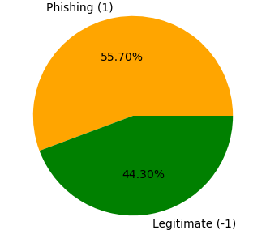
CLASS DISTRIBUTION IN DATASET

Slide 10
The pie chart provided illustrates the class distribution within my dataset, distinguishing between phishing (-1) and legitimate (1) websites. The chart shows a relatively balanced distribution because because neither class is significantly underrepresented; the two classes are within about 10 percentage points of each other.
Having a balanced dataset is crucial for training machine learning models because:
It helps ensure that the model does not become biased toward the more common class.
It improves the reliability of accuracy as a metric for model performance.
It allows for better generalization of the model when predicting new, unseen data.

Slide 11
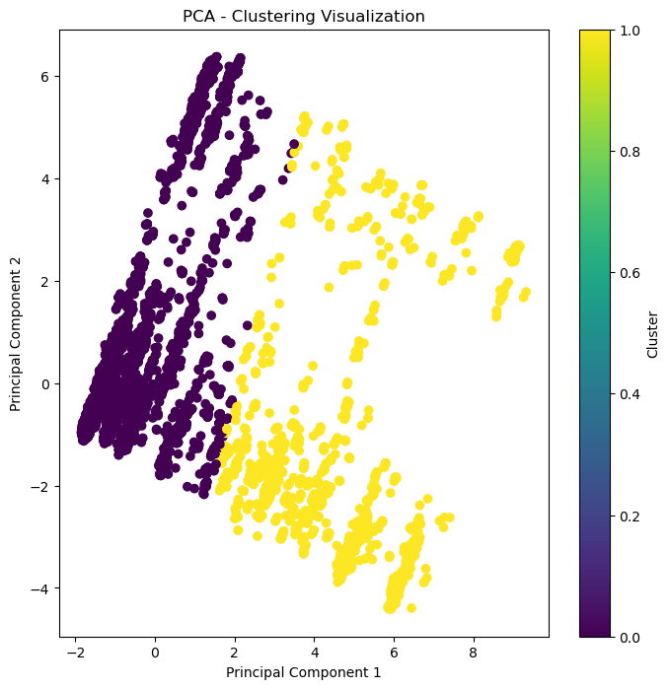
PCA – CLUSTERING VISUALIZATION

Slide 12
PCA-Clustering Analysis
Feature Extraction: It separates the dataset into features (features) and labels (labels), preparing the data for further analysis.
Standardization: The StandardScaler scales the features to have a mean of 0 and a standard deviation of 1, which is crucial for PCA and many machine learning algorithms to perform well.
PCA Application: PCA reduces the dimensionality of the data to 2 principal components for visualization purposes, making it easier to identify patterns or clusters in the data visually.
Clustering with KMeans: Applies the KMeans clustering algorithm to the PCA-reduced data to identify two clusters, assuming these might correspond to phishing and legitimate websites based on their features.
Visualization: The final step visualizes the clusters in a 2D plot, where the x-axis represents the first principal component, the y-axis represents the second, and the color indicates the cluster assignment. This visualization helps in understanding how well the clustering algorithm has managed to separate the phishing websites from the legitimate ones based on the reduced features.
For example, if the phishing and legitimate websites are well-separated in the plot, it suggests that the features and the PCA transformation effectively capture the differences between these two types of websites.

Slide 13
PCA is a dimensionality reduction technique that transforms the data into a new coordinate system with the axes called principal components (PCs).
In this plot, only the first two principal components are visualized, which typically capture the most significant patterns in the data.
Clusters:
The different colors in the plot represent different clusters found in the data. A clustering algorithm like KMeans used to partition the data points into these clusters based on their similarity.

Slide 14
Interpretation of Patterns:
Data points that are close together in the PCA plot are similar to each other in terms of their original features, while points that are far apart are more dissimilar.
Clusters of points indicate groups of URLs with similar features that could correspond to either phishing or legitimate websites.

Slide 15
Feature Relationships: The visualization suggests how features related to websites might be associated with each other after reducing dimensionality, helping identify features that are most indicative of phishing versus legitimate websites.
Model Insights: This plot can give insights into how well the PCA-transformed features might separate different classes of websites, which is valuable for building a predictive model.
Cluster Analysis: Analyzing the clusters can help understand the characteristics that differentiate between different types of websites, such as those that are clearly legitimate, clearly phishing, or potentially suspicious

Slide 16
NOTE:
PCA is an unsupervised technique and does not use class labels for the dimensionality reduction. The clusters are identified post-PCA based on the proximity of points in the reduced feature space.

Slide 17
WEEK 5 TARGET -FEATURE EXTRACTION:

Slide 18
Feature Extraction from URLs:
Feature extraction plays a crucial role in the field of phishing detection, where the goal is to differentiate between legitimate and malicious websites. Phishing is a form of cyber attack where attackers create deceptive websites that mimic legitimate ones to steal sensitive information from unsuspecting users. Detecting these malicious websites requires analyzing various aspects of their URLs to identify patterns or characteristics indicative of phishing behavior.
Features are essentially characteristics or attributes derived from the URL that provide valuable information for distinguishing between phishing and legitimate websites. These features serve as inputs to machine learning algorithms or other detection mechanisms, helping to automate the process of identifying potential threats.

Slide 19
By extracting features from URLs, we can analyze different aspects of the website address, such as its structure, components, and associated metadata. These features can include:
1. Domain-related features: Information about the domain name, its length, age, and registration details.
2. URL structure features: Characteristics of the URL path, such as its length, presence of special characters, or redirections.
3. Content-related features: Analysis of the content accessible through the URL, including the presence of certain keywords, scripts, or embedded resources.
4. External factors: Interaction with external data sources, such as WHOIS databases or reputation services, to gather additional information about the website.
By leveraging these features, we can build models that learn to distinguish between phishing and legitimate websites based on the observed patterns and characteristics. This allows for the automated detection of phishing attempts, providing users with enhanced security and protection against online threats.

Slide 20
Overview of Feature Extraction Methods:
Domain-Based Features:
Length of the domain: The number of characters in the domain name.
Presence of hyphens: Indicates whether the domain contains hyphens, which may be associated with suspicious domains.
Age of the domain: The length of time since the domain was registered, obtained from WHOIS data.
Top-level domain (TLD): The extension of the domain (e.g., .com, .org, .edu), which can provide insights into the nature of the website.
URL Structure Features:
Length of the URL: The number of characters in the URL, which can indicate complexity or suspiciousness.
Presence of special characters: Detection of unusual characters or symbols in the URL.
Redirections: Identification of URL redirections, which may be used to obfuscate the true destination of the website.
Subdomains: Analysis of the presence and number of subdomains in the URL.

Slide 21
Overview of Feature Extraction Methods:
Content-Based Features:
Keywords in the URL: Detection of specific keywords or patterns associated with phishing attempts.
Embedded resources: Examination of embedded resources (e.g., images, scripts) linked in the URL.
Favicon presence: Presence of a favicon associated with the website, which can indicate authenticity.
External Data Features:
WHOIS data: Analysis of registration details, including registrar, creation date, and expiration date.
Reputation scores: Integration with reputation services to obtain scores indicating the trustworthiness of the website.
Alexa rank: Ranking of website popularity obtained from Alexa, which may provide insights into the website's legitimacy.

Slide 22

Methods of Feature Extraction Process:
URL Parsing: Utilizing libraries or methods to parse and dissect the URL into its components.
Regular Expression Matching: Employing regular expressions to search for patterns or substrings within the URL or associated data.
External Data Interaction: Interacting with external sources, such as WHOIS databases or ranking services, to obtain additional information related to the URL.

Slide 23
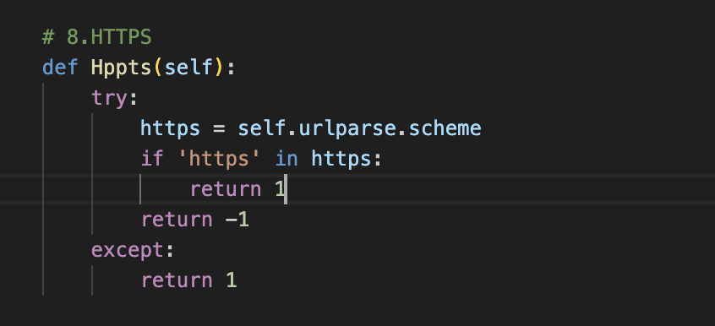
Code Example and Implementation Details:
The Https method checks if the URL uses HTTPS (Hypertext Transfer Protocol Secure). If the URL's scheme includes 'https', indicating a secure connection, it returns 1, suggesting a legitimate site. Otherwise, it returns -1, indicating potential phishing. However, the exception handling seems to contradict typical expectations by returning 1 when an exception occurs..

Slide 24

Significance of Feature Extraction
1. Importance of Meaningful Features:
Meaningful features provide valuable insights into the characteristics of URLs that distinguish phishing websites from legitimate ones.
By extracting relevant features, we can uncover patterns and indicators of phishing behavior, such as suspicious domain structures or deceptive URL components.
Meaningful features serve as the foundation for building effective machine learning models that can accurately classify URLs as either phishing or legitimate based on their characteristics.
2. Contribution to Model Robustness:
Meaningful features enhance the robustness of machine learning models by providing comprehensive information about URLs.
Robust models rely on a diverse set of features that capture different aspects of URLs, making them more resilient to variations and complexities in phishing techniques.
Incorporating a wide range of meaningful features helps mitigate the risk of overfitting and ensures that the model can generalize well to unseen data, improving its overall performance and reliability.

Slide 25
3.Enhancing Detection Accuracy:
Meaningful features play a crucial role in improving the accuracy of phishing detection systems.
By accurately capturing the distinguishing characteristics of phishing URLs, these features enable models to make more precise predictions and minimize false positives and false negatives.
Enhanced detection accuracy leads to better identification of potential phishing threats, enabling timely and effective mitigation measures to protect users from falling victim to phishing attacks.
4. Adaptability to Evolving Threats:
Meaningful features provide a flexible framework for adapting to evolving phishing threats and tactics.
As phishing techniques evolve and new patterns emerge, feature extraction methods can be updated to capture these changes and incorporate them into the detection process.
The adaptability of feature-based detection systems allows them to stay ahead of emerging threats and maintain high levels of effectiveness in detecting even the most sophisticated phishing attempts.

Slide 26
Week 6-7-8 :Development and Training of Machine Learning Model.
TO BE CONTINUED…..

